Slide 1


Strategic Planning
Nakhonratchasima Institute for Skill Development Region5
By
Planing and Evaluation Section

Slide 2



Physical appearance and location of the organization
- Nakhonratchasima province , also known as "Korat“
- as a gateway to the east.
- Approximately 256 kilometers from Bangkok.
- Is the largest city on the plateau region. Rich in resources and tourist facilities.
- The two largest areas of the country. ( largest province is Chiang Mai.)
- Nakhonratchasima is divided into 32 administrative districts.
- The labor force is 1,502,604 people.
Accounted for 53.19 percent of the total population
- The growth of the economy. There are many more industries

Slide 3
Dimensional structure of the organization
Nakhonratchasima Institute for Skill Development Region5 = NISD
Structure of the complex. There are a number of vertical levels in the hierarchy
- Organization structure is Machine Bureaucracy
Director
Policies and decisions
middle management group.
- collaboration
-Planning and Evaluation
-skill standard
Support
- Finance Accounting. General/HR
The main practical training
Mechanics/ Electrical and Computer/ Mechanical/ Construction

Slide 4
Environment scanning & strategic issue
Internal
- Structure (Chain of command)
NISD: vertical levels
- Culture (values, expectation)
NISD: service, learning ,team- work, network
- Resources
NISD: skill, competency, knowledge
External
Societal Environment
NISD: Economic forces, Technological forces, political
- Task Environment
NISD: special interest group, employer, employee/labour, customers
Strategy Formulation

Slide 5
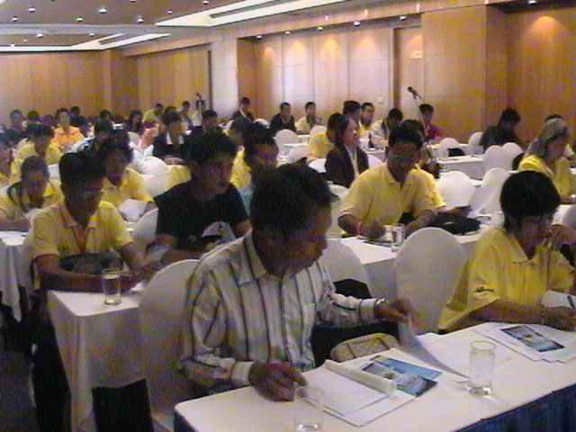


NISD vision
Thai workers have the skills standards. Sustain the economy. The concept of cooperation.
Shared values
1. spiritual service Serves as the family.
2. Pursuing a learning innovation.
3. Work proactively as a team
4. Happy work with the network.
Notes:
5
วันศุกร์ที่ 22 พฤษภาคม 2552

Slide 6
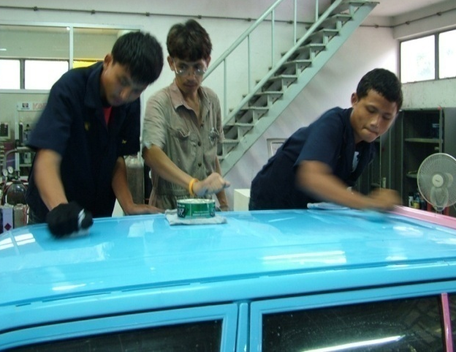
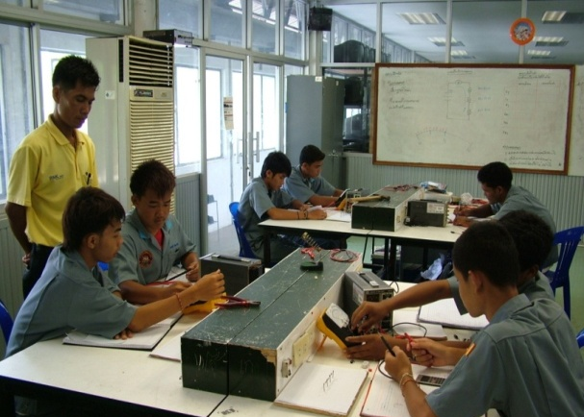
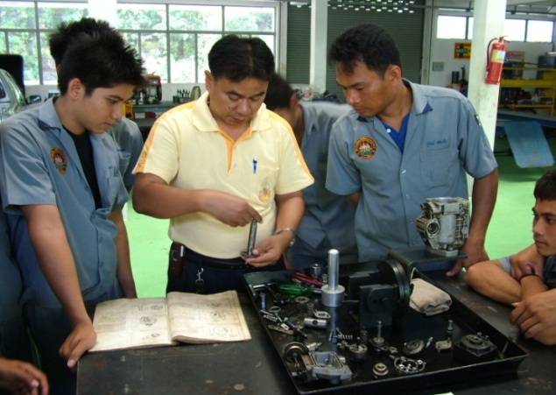
NISD MISION
1.Promote participation and networking to drive the development of labor force in Nakhonratchasima province.
2. Development Standards and the National Skill Standards to meet the needs of workers in Establishment.
3.The potential labor force growth of the economy in the province of Nakhonratchasima and increase competitiveness
4. To develop and enhance professional skills for the labor force. Support the labor movement in the province

Slide 7
NISD GOAL /objective
labor force growth of the economy in Nakhonratchasima province and increase competitiveness

Slide 8
NISD: Key success factors
(first year action plan)
NISD:
1. The potential labor force growth of the economy
With the competency of each location together with the establishment. To be used to develop employee training programs to meet the needs and Labor standards can only position and provide instruction has been completed.
(first year can : 3 establishment)
2. Promote participation and networking
with skill development promotion act.

Slide 9
NISD: Business plan
(three year if applicable)
1. Networking to drive the development of labor force in Nakhonratchasima
Standards to meet the needs of workers in Establishment.
2.Development the National Skill Standards to meet the needs
3. labor force growth of the economy and increase competitiveness
4. To develop and enhance professional skills for the labor force. Support the labor movement in the province
Year 2015 183 establishment | Year 2016 205 establishment | Year 2017 219 establishment
5 establishment | 7 establishment | 9 establishment
85% of total labor force | 90% of total labor force | 95% of total labor force
75% of total labor force | 80% of total labor force | 85% of total labor force

Slide 10
NISD: Strategy Implementation
-Program
-Budgets
-Procedure

Slide 11
NISD: Evaluaation & Control
Performance
- Actual result
KPI
BSC
SAR ……

Slide 12
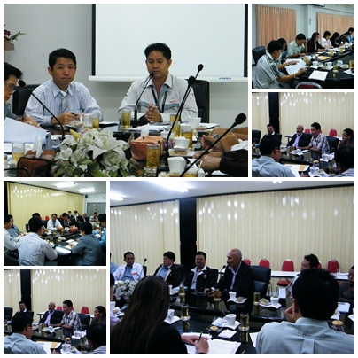
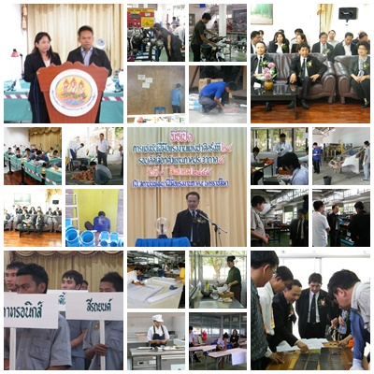
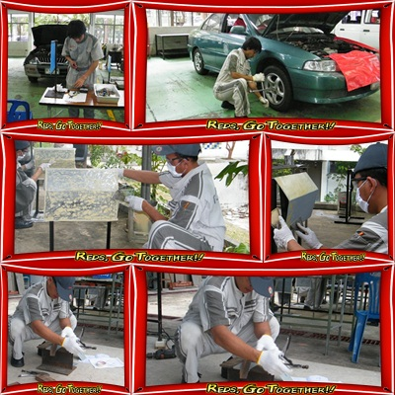
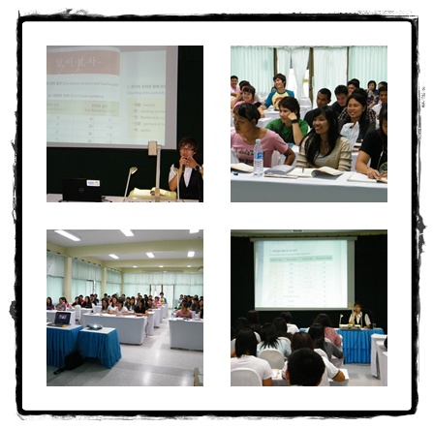
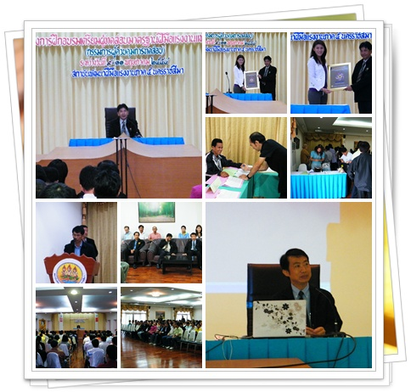
Strategy to work is important as strategy formulation. Management is critical in determining the guidelines for its implementation
9

Slide 13
Interesting ideas.
“Strategy without tactics is the slowest route to victory.
Tactics without Strategy is the noise before defeat”
Sun Tzu
Chinese General and Author, b 500BC

Slide 14
Thank you for your attention
Thank you all of Staff

